Slide 1
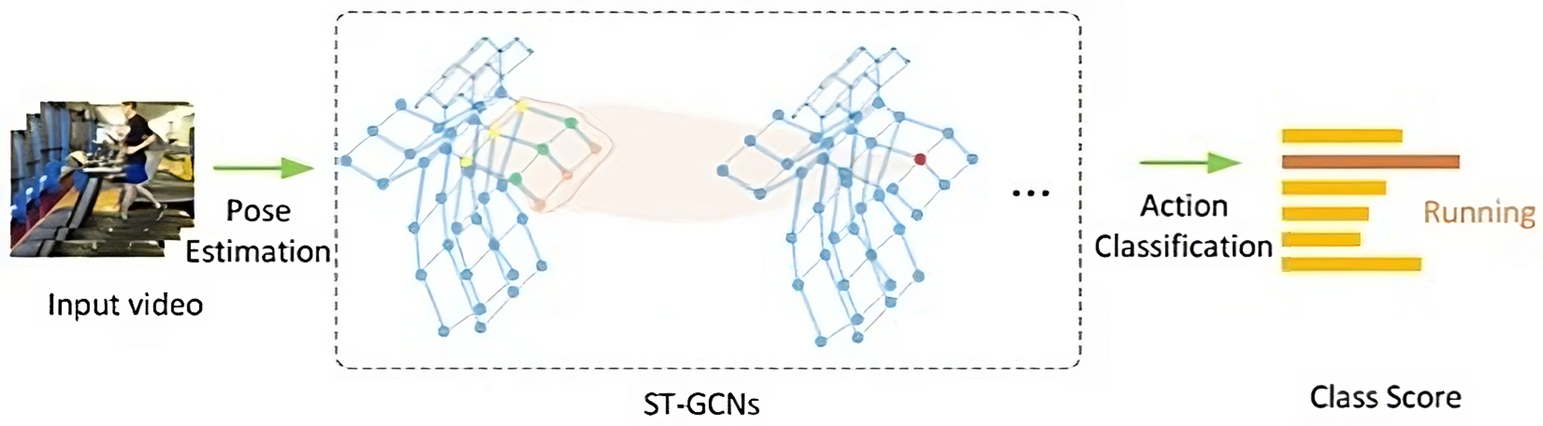

Make Skeleton-based Action Recognition Model
Smaller, Faster and Better
Fan Yang, Sakriani Sakti, Yang Wu, Satoshi Nakamura
Nara Institute of Science and Technology Japan RIKEN, AIP, Japan Kyoto University, Japan

Slide 2
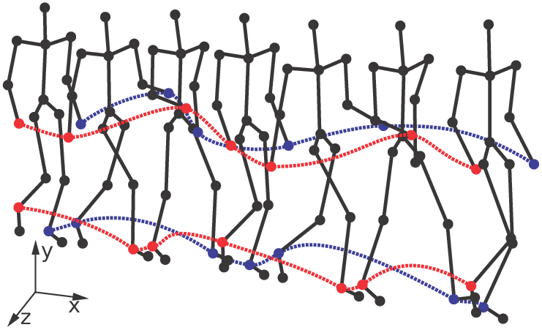
INTRODUCTION TO THE PROBLEM
Issues to address:
Large model size
Slow execution speed
Location-viewpoint invariant features
Global motion information
A desirable model should:
Run efficiently with few parameters
Be adaptable to various application scenarios
Objective: define a fast and light base model
Spatial embedding
RNNs
CNNs
Action
Temporal embedding
…

Slide 3
METHODOLOGY: FEATURE SELECTION
Location-viewpoint invariant features
Global motion information

Slide 4
FEATURE SELECTION
Commonly used
Proposed
Cartesian coordinates
Joint Collection Distances (JCD)
Variant to locations and viewpoints
Location-viewpoint invariant
It does not contain global motion information
Geometric feature
(e.g. angles/distance)
Location-viewpoint invariant
It may need to be heavily redesigned from one dataset to another, or contain redundant elements
Global motions
Location-invariant

Slide 5
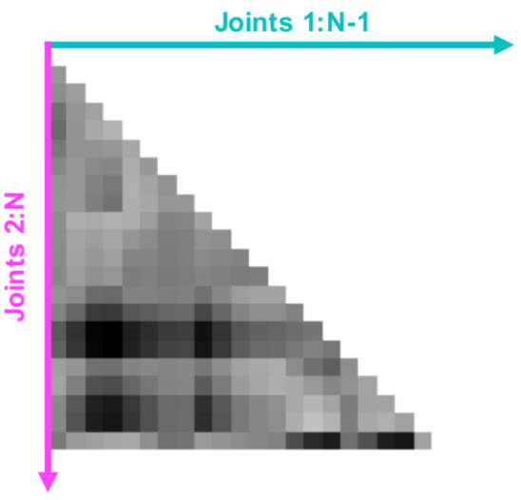
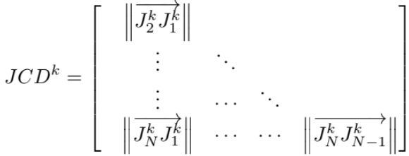
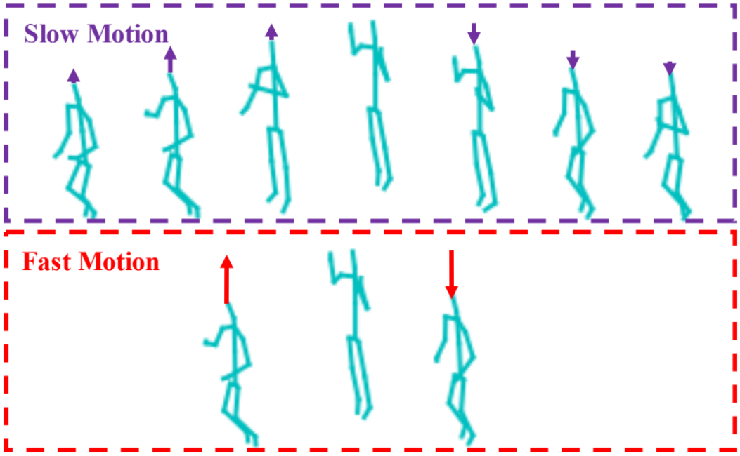
ROBUST FEATURES EMPLOYED
Joint Collection Distances (JCD)
Global motions
The Euclidean distances between a pair of collective joints produces a symmetric matrix.
The temporal differences (i.e. the speed) of the Cartesian coordinate feature.
An example of Joint Collection Distances (JCD) feature at frame k, where the number of joints is N.

Slide 6
METHODOLOGY: MODEL ARCHITECTURE
Small model size (i.e. few parameters)
Fast execution speed
Adaptability to various scenarios

Slide 7
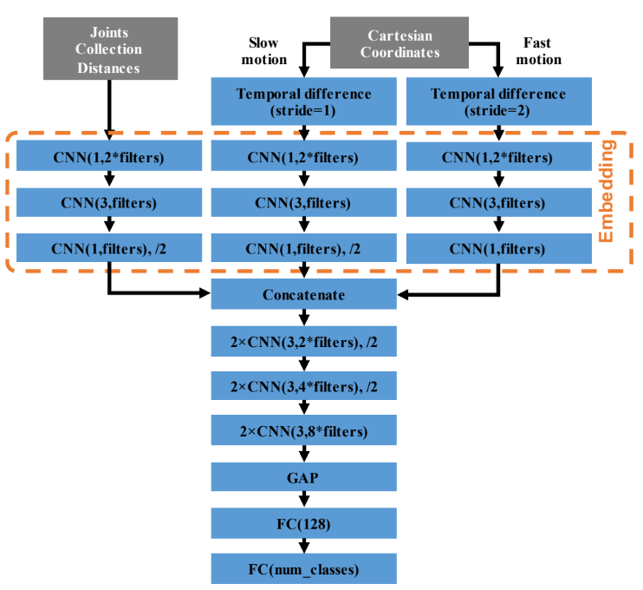
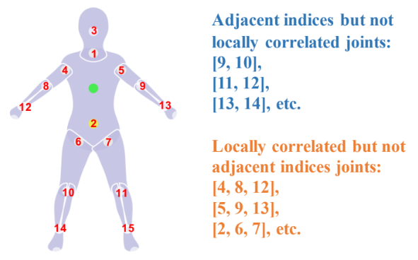
MODEL ARCHITECTURE
Double-feature Double-motion Network
(DD-Net)
Directly processing the locally uncorrelated joint feature is inappropriate.
Therefore, DD-Net embeds the features into latent vectors at each frame.
The correlation of joints is automatically learned through the embedding.
The JCD and Slow motion features have double the temporal length of the Fast motion feature

Slide 8
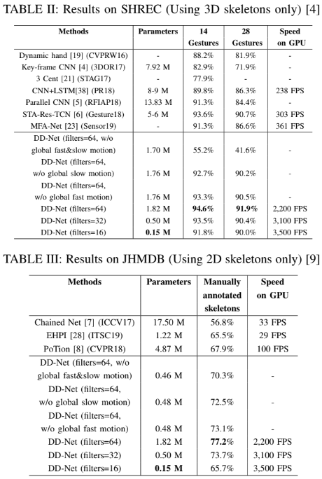
EVALUATION AND RESULTS
DD-Net (filters=64)
Parameters: 1.82 M
14 Gestures: 94.6%, 28 Gestures: 91.9%
Speed on GPU: 2,200 FPS
DD-Net (filters=16)
Parameters: 0.15 M
14 Gestures: 91.8%, 28 Gestures: 90.0%
Speed on GPU: 3,500 FPS
DD-Net (filters=64)
Parameters: 1.82 M
Manually annotated skeletons: 77.2%
Speed on GPU: 2,200 FPS
DD-Net (filters=16)
Parameters: 0.15 M
Manually annotated skeletons: 65.7%
Speed on GPU: 3,500 FPS

Slide 9
BASELINE FOR LARGER MODELS
How to improve this as a base model
How to improve on this base model
RGB or depth data
Temportal action detection with temporal segmentation modules
Can the global motion feature embedding be generalized?
Define a measure of ‘relevance’ for the global motion feature for pre-processing
Ensemble Deep Learning motion extraction with LSTMs
Would vertical expansion of the model give better improvements than horizontal?
Would it be efficient to use this as a baseline? Are the features general enough?
Ensemble techniques to make use of the light and fast architecture and parallel computing

Slide 10
THANK YOU FOR YOUR ATTENTION

